Slide 1
Version Control

Slide 2
What is Version Control?
Version control – a system for recording and managing changes made to file/s
The system will keep track of the changes to allow for a complete retrace of each file
The system will also allow multiple developers to work on same project without affecting

Slide 3
What is Git?
Git – a free open source version control system
Rather than store file-based changes Git stores a reference to snapshot of the amended files
Git utilises local files and resources
Git is checksummed
With Git you are unlikely to lose data
Git repository is the folder .git that tracks all changes to file/s

Slide 4
The Git States
The three main states of Git are:
Modified – changes have been made to the file
Staged – marked file for next commit snapshot
Commit – data saved in local repository/database

Slide 5
The Git Workflow
The basic Git Workflow is as follows:
Modify the files
Stage the files
Commit the files

Slide 6
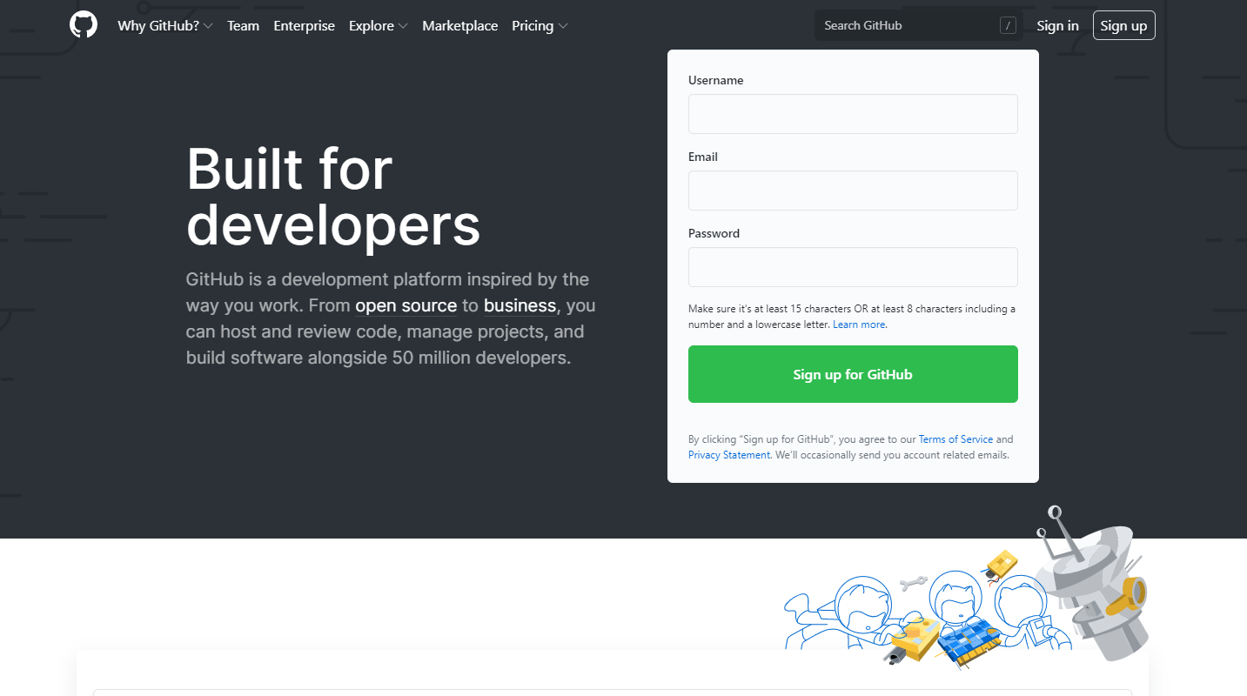
GitHub

Slide 7
Pushing To A Remote
Git allows you to push changes data to a remote server
GitHub – remote server
After committing changes you can then push them to a remote server

Slide 8
Git Branches
Git branches enable you work away from main project without interference
Branches sets Git apart from other Version Control Systems
Git branch operations including switching between branches very fast
Workflows that uses branches encouraged
Branches can be merged
The default branch name is master

